Slide 1
NFT HUB
Kamalesh K
Gowshika R
Soundharya K
Andrews d Edberg

Slide 2
Abstract
Our project is an E-commerce website to buy NFT’s which is already created by creators. The project allow seller to upload the NFT’s.
The user can buy it. And the project as an option of like button this will increase the cost of the product.

Slide 3
Problem Statement
There are many issues you may face during the NFT marketplace development, like high and hidden fees, legal issues, lack of creativity for creators, poor customer support, and more.
NFT projects fail due to a lack of planning, bad decision making, an unprofessional team, and a lack of passion, all can crash an otherwise promising NFT project.
The main challenge faced in the NFT market is the uncertainty in determining the price of the NFT. Now, the price of any NFT will depend on the creativity, uniqueness, scarcity of the buyers and owners, and a lot more.

Slide 4
Proposed Solution
We Addressed the above problems and made it very easy to buyers and taking NFT’s to all kind of people.
Price here is not Uncertain we are selling in fixed price and only certain NFT’s price will increase based on the likes.
By tying ownership of natively digital artwork to an entry in a public, immutable ledger, the artwork becomes collectable.

Slide 5
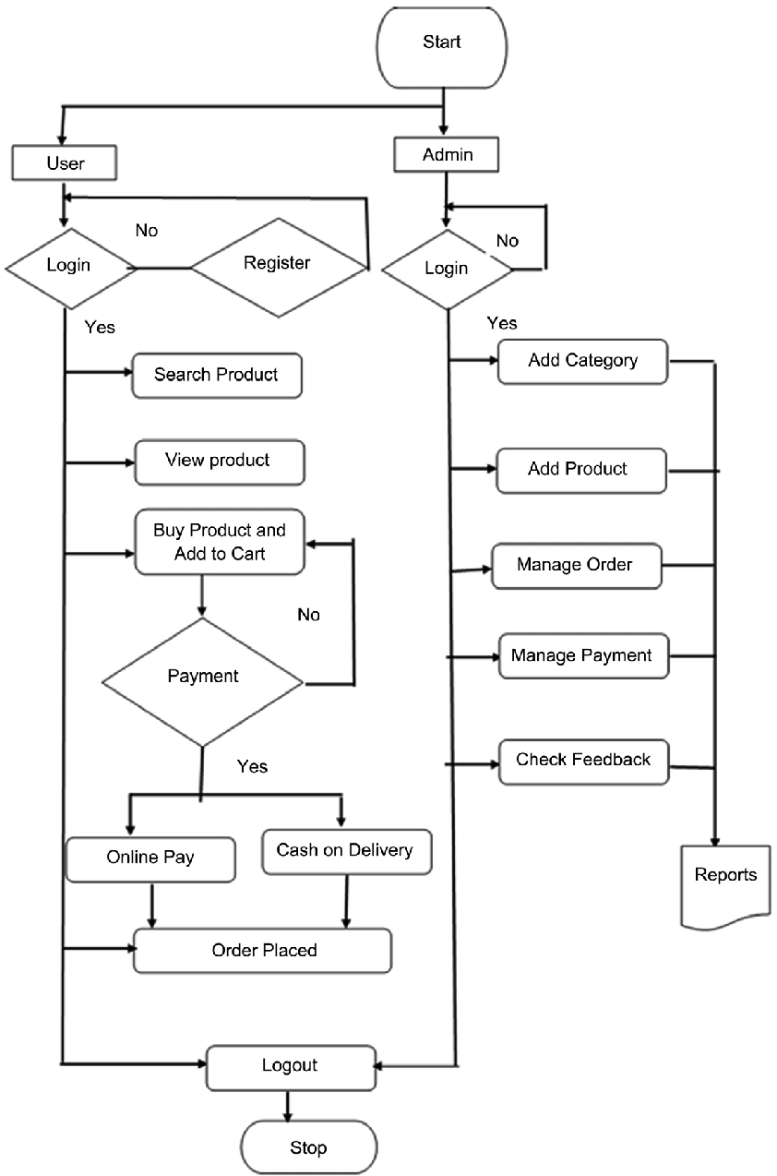
System Architecture

Slide 6
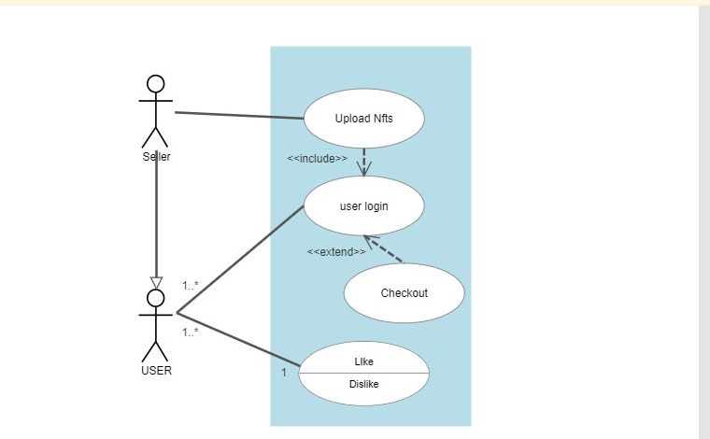
Use Case Diagram

Slide 7
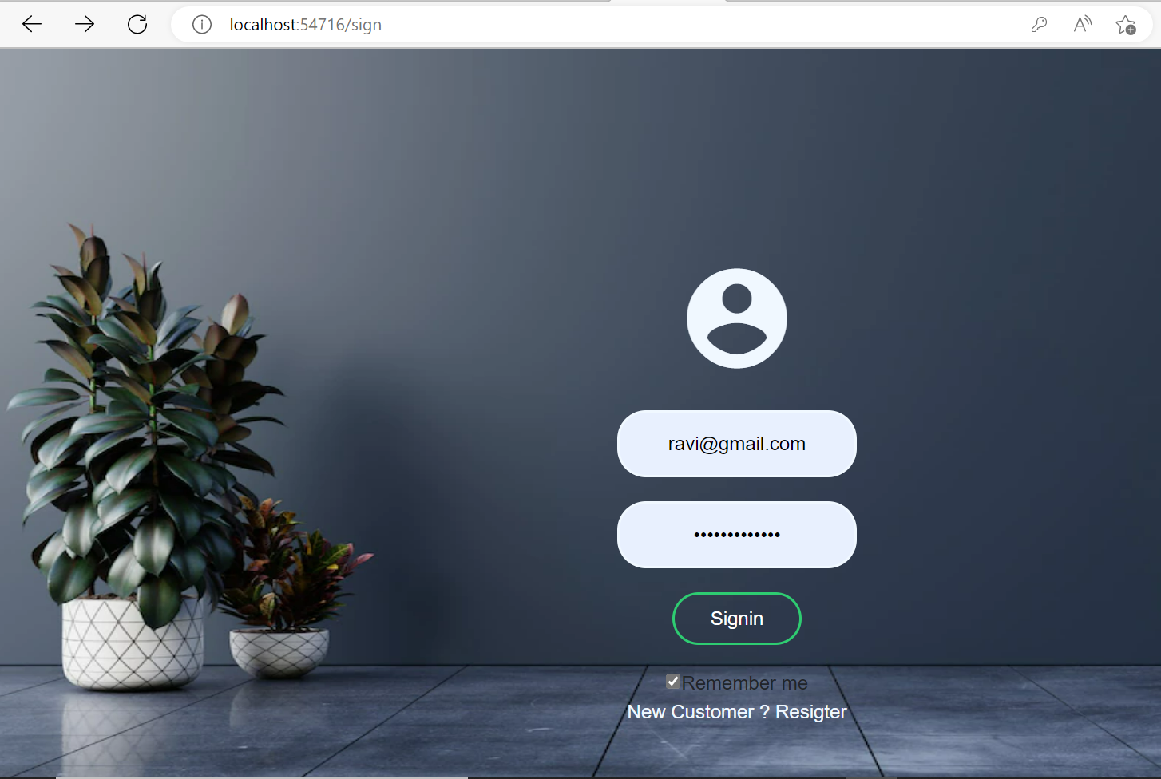
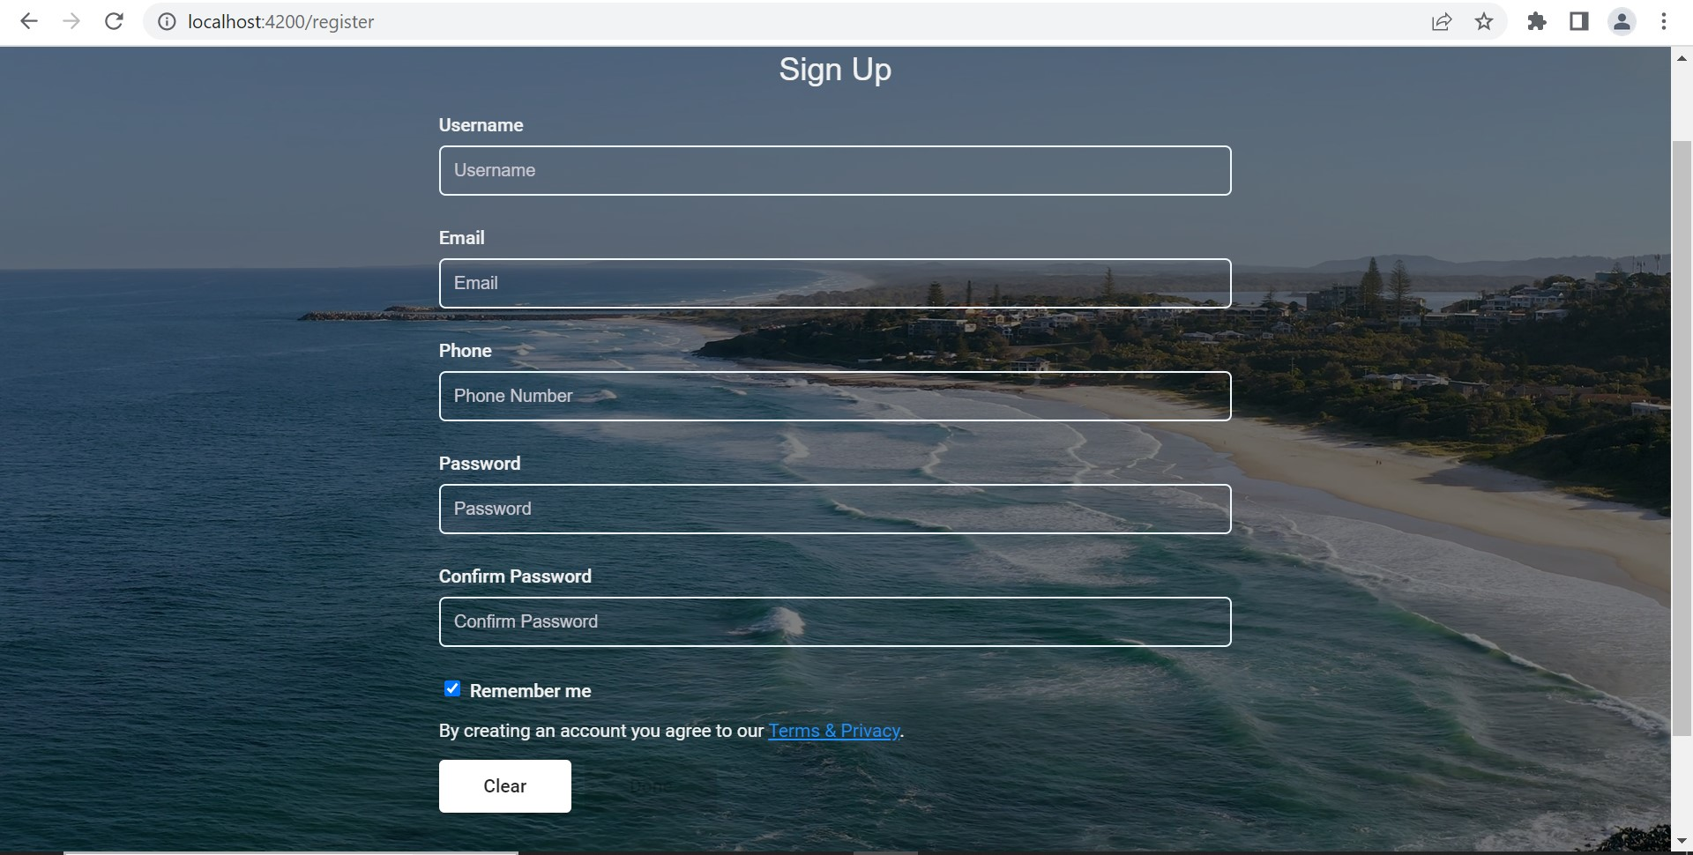
Login page Register page

Slide 8
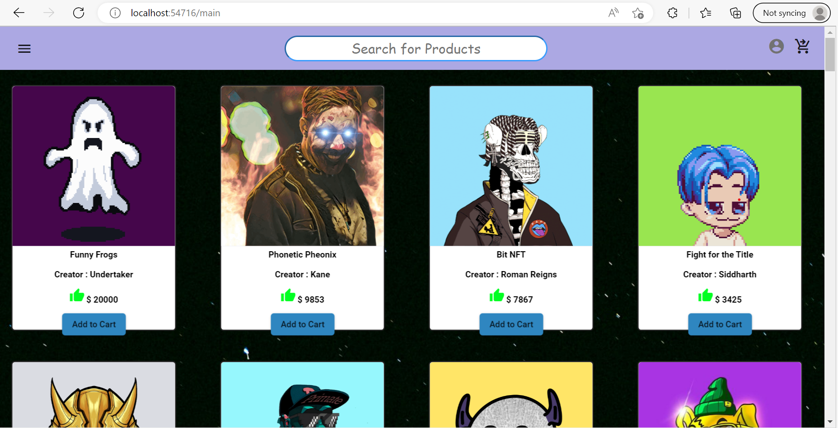
Main Page

Slide 9
Conclusion
Conclusion. The Non-Fungible Token has shaken the world and made the NFT marketplaces boom with rapid trading. Users are attracting massive profits and enjoying benefits thus promoting NFTs as a new profitable investment scheme.
As with any emerging technology, businesses building NFT projects now will have the advantage of early adopters. NFTs allow businesses to connect with their audience in new ways by pro

Slide 10
Thank You

